Slide 1
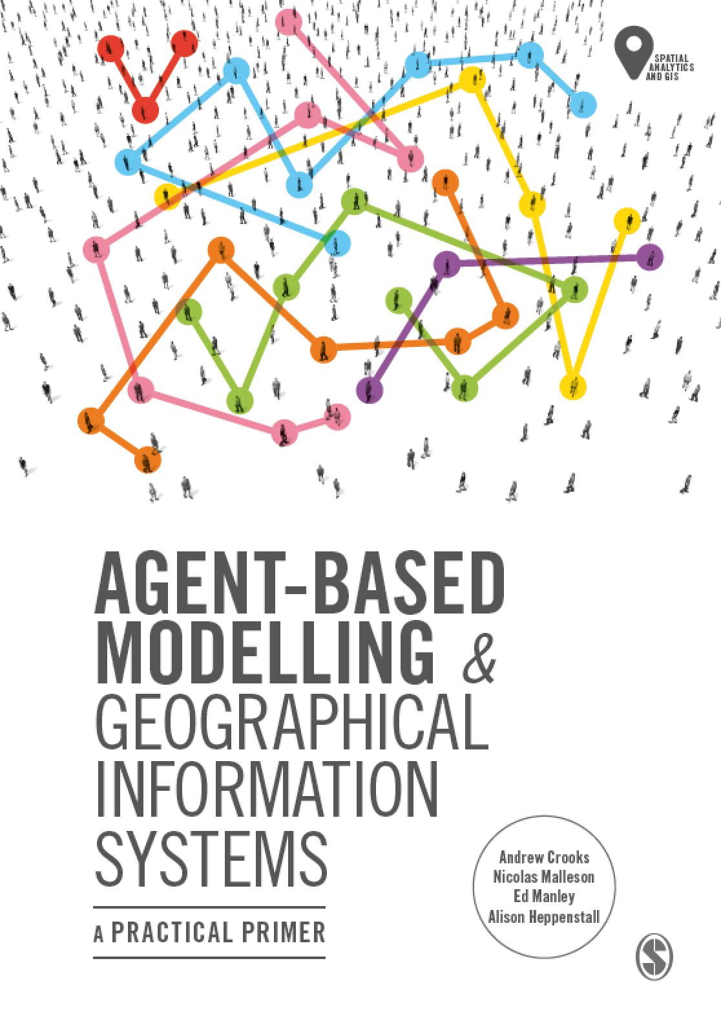
Chapter 2
Introduction to Agent-Based Modelling
Notes:
In this Chapter we introduce the key concepts behind agent-based modelling. What is an agent, and what are rules? These are discussed along with a consideration of the main advantages and disadvantages for simulating spatial systems. A range of established applications are presented to give a flavour of how agent-based models can be successfully applied. The overarching aim of this chapter is to give the reader an understanding of what an agent-based model is. This knowledge will be built upon in subsequent chapters.

Slide 2
Learning Objectives
The overarching aim of this chapter is to give the reader an understanding of what an agent-based model is.
Set the scene for the following chapters which go into more details about agent-based modeling.
Introduce key concepts behind agent-based models
E.g., What is an agent, and what are rules?
Outline the main advantages and disadvantages for simulating spatial systems.
Demonstrate how agent-based models can be successfully applied to a range applications.

Slide 3
Introduction

Slide 4
What is an Agent?

Slide 5
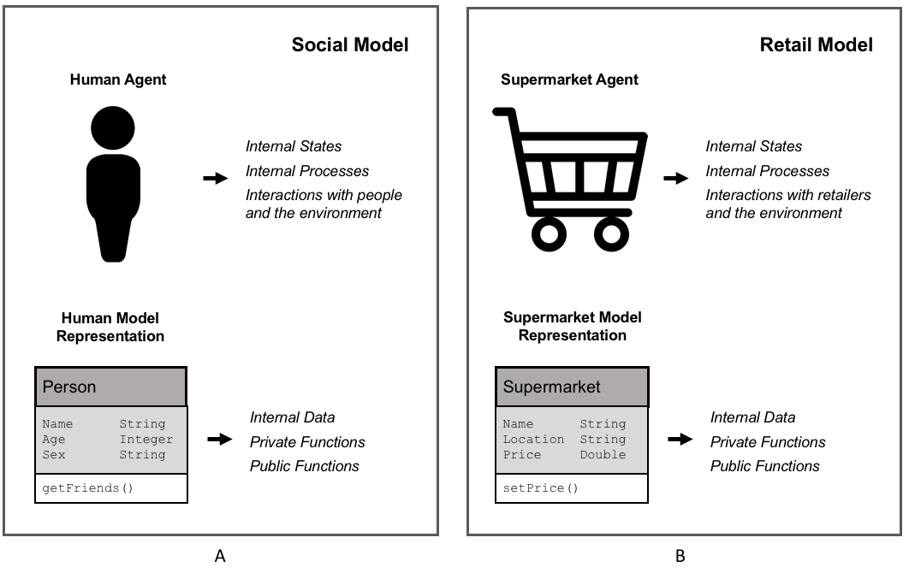
Agent Representation
Figure 2.1: Representation of (A) human agent and (B) supermarket retailer agent alongside that of representation within an object-orientated environment.

Slide 6
Agent Rules

Slide 7
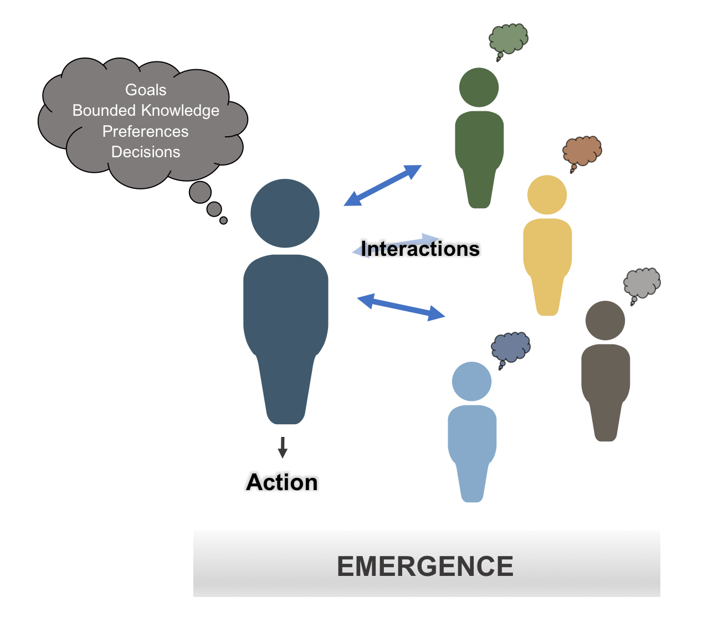
Main Components of an Agent
Figure 2.2: Schematic illustrating some of the main components of an agent.

Slide 8
An Agent’s World

Slide 9
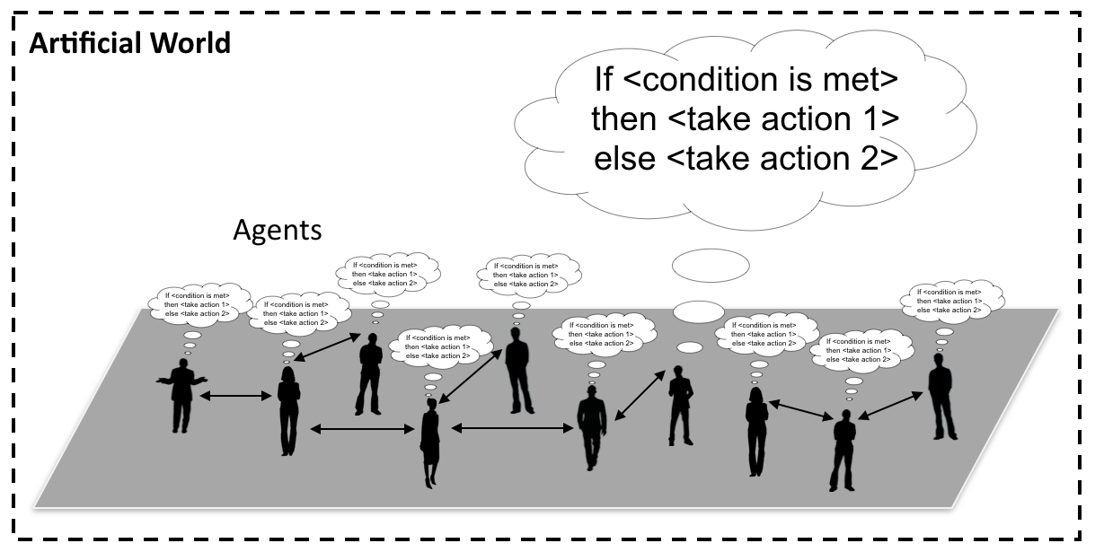
Agents and their “World”
Figure 2.3: Conceptualization of an agent-based model where people are connected to each other and take actions when a specific condition is met.

Slide 10
Advantages of Agent-based Modelling

Slide 11
Limitations of Agent-based Modelling

Slide 12
A Gallery of Applications

Slide 13
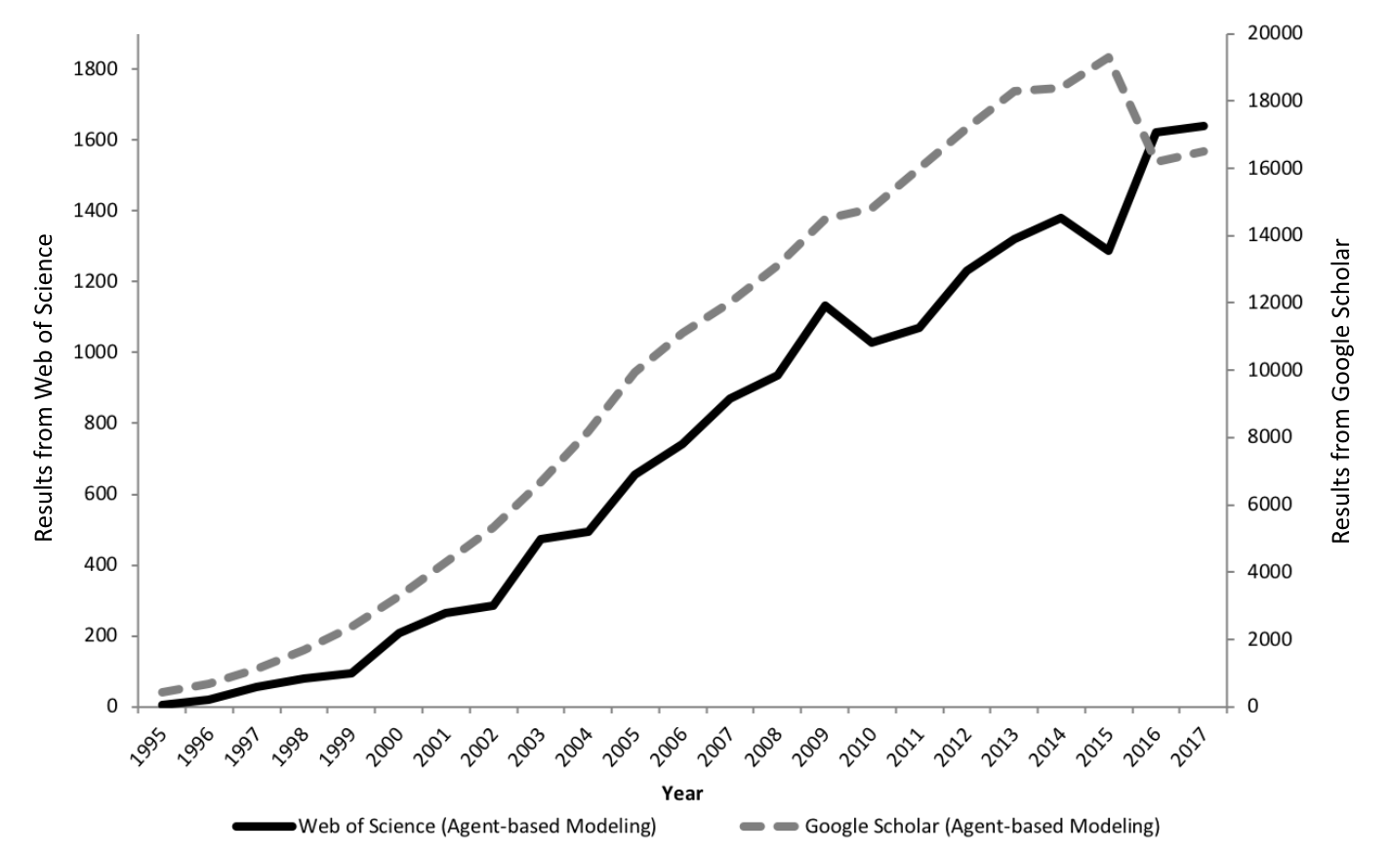
The Growth of Agent-based Modelling
Figure 2.4: The growth in agent-based modelling: from search results of Web of Science and Google Scholar.

Slide 14
Segregation
When we see patterns of segregated neighborhoods , the process that led to them has already happened.
What causes such patterns to emerge?
Schelling (1971) explored the idea of how mild tastes and preferences for like demographic groups could lead to patterns of segregation we observe in a abstract setting.
Simple model where agents check their surrounding cells (i.e. their neighbors) and sees if it is happy in the current location.
If the agent is not happy it moves to a new location.
Schelling, T. C. (1971). Dynamic models of segregation. Journal of Mathematical Sociology, 1(2), 143-186.

Slide 15
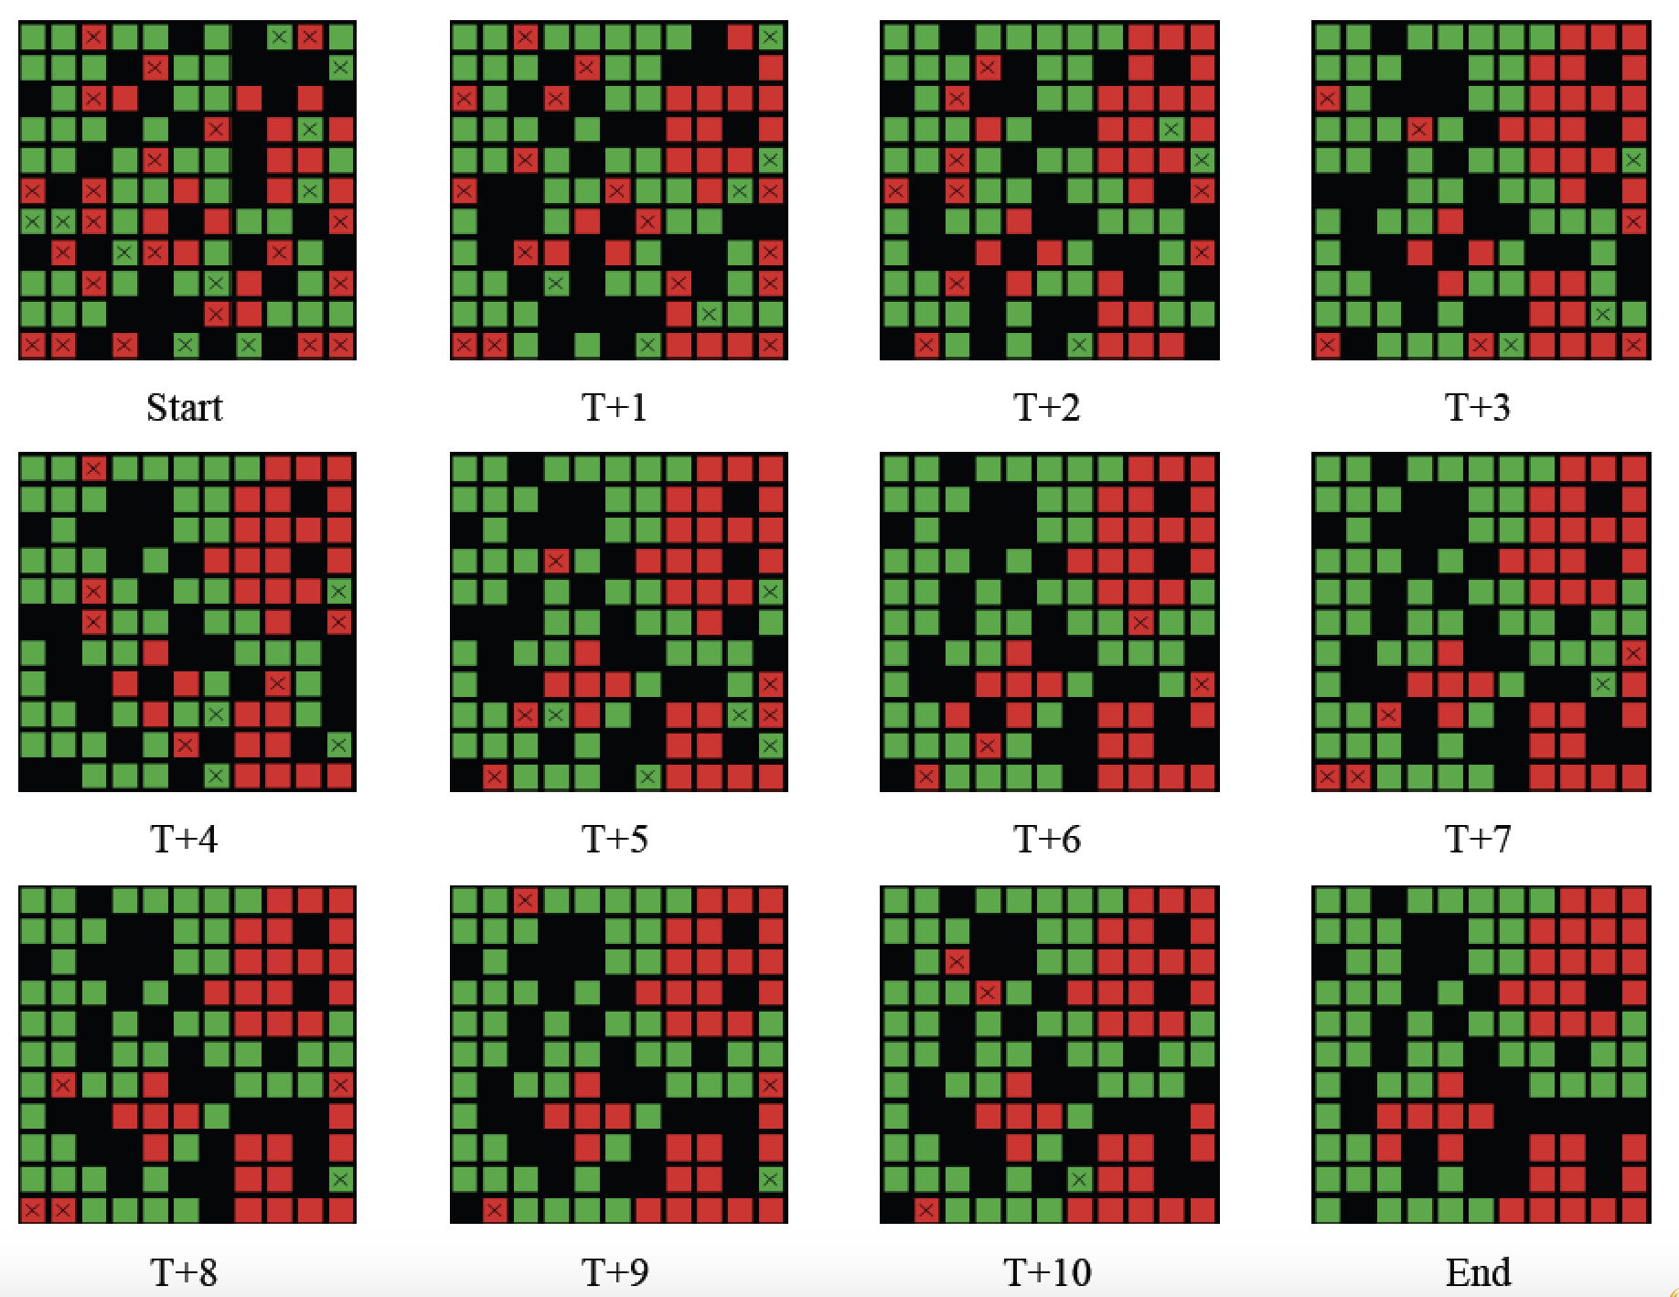
Progression of Segregation over Time
Figure 2.5: Progression of segregation over time: Agents what to live in a neighborhood where 40% are of the same color.

Slide 16
Changing Agents Preferences
Open up NetLogo’s Segregation Model
Once open, press the “setup” and then “go” buttons.
Watch how agents move to find neighborhoods they are satisfied with.
Change “%-similar-wanted” slider (which is the agents preference for neighborhood composition).
Press the “setup” and then “go” buttons.
Watch how agents move to find neighborhoods they are satisfied with.
Experiment with different values for “%-similar-wanted”
Is there at critical point were patterns of segregation become more distinct?

Slide 17
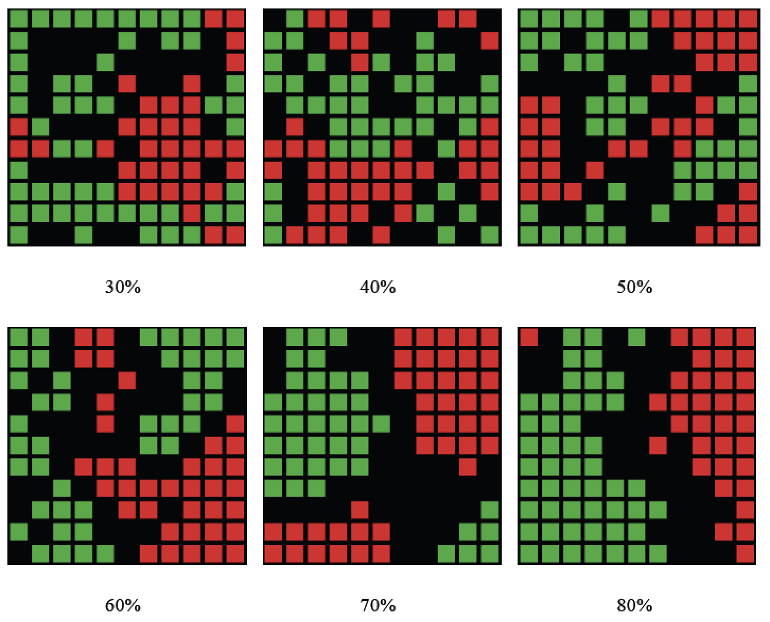
Changing Agents Preferences
Figure 2.6: Examples of how changing agents neighborhood preference levels leads to different patterns of segregation emerging.

Slide 18
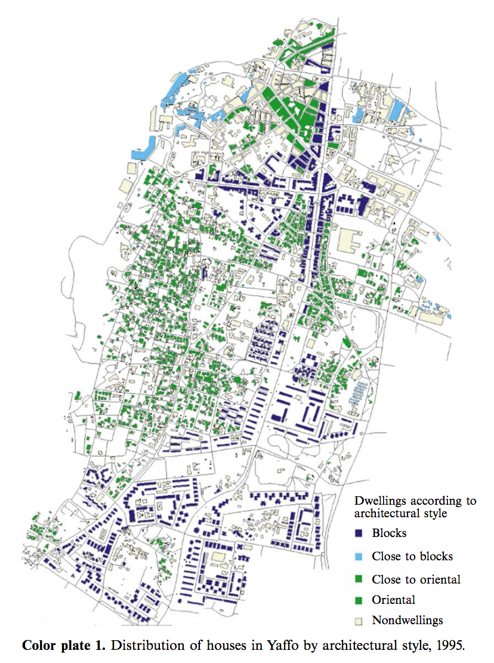
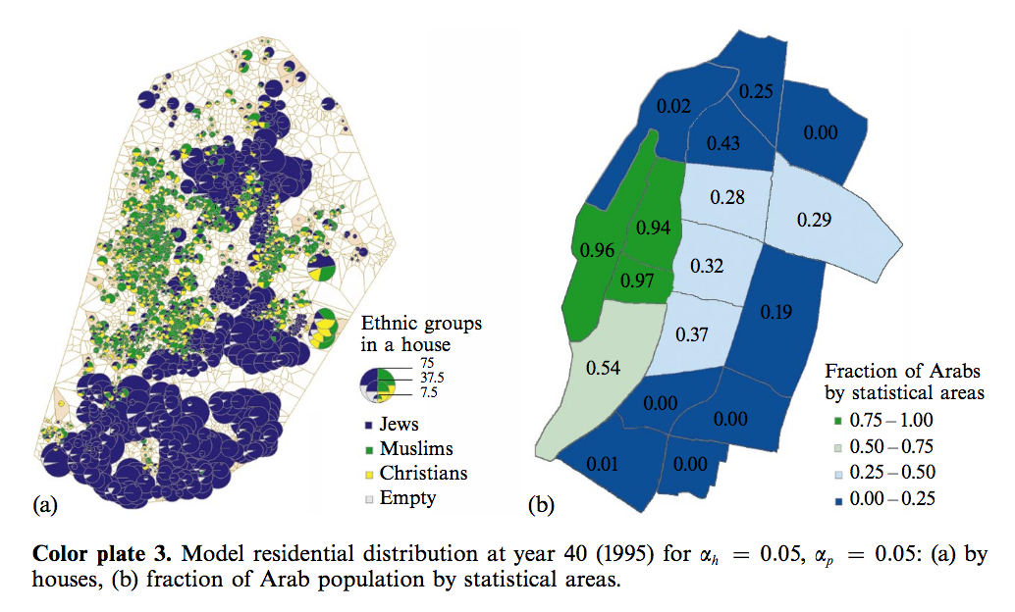
From Abstract to Real World Applications
Add details about Benenson et al., 2002
Source: I. Benenson, I. Omer, E. Hatna, 2002, “Entity-based modeling of urban residential dynamics - the case of Yaffo, Tel-Aviv.” Environment and Planning B, 29: 491-512.

Slide 19
SugarScape

Slide 20
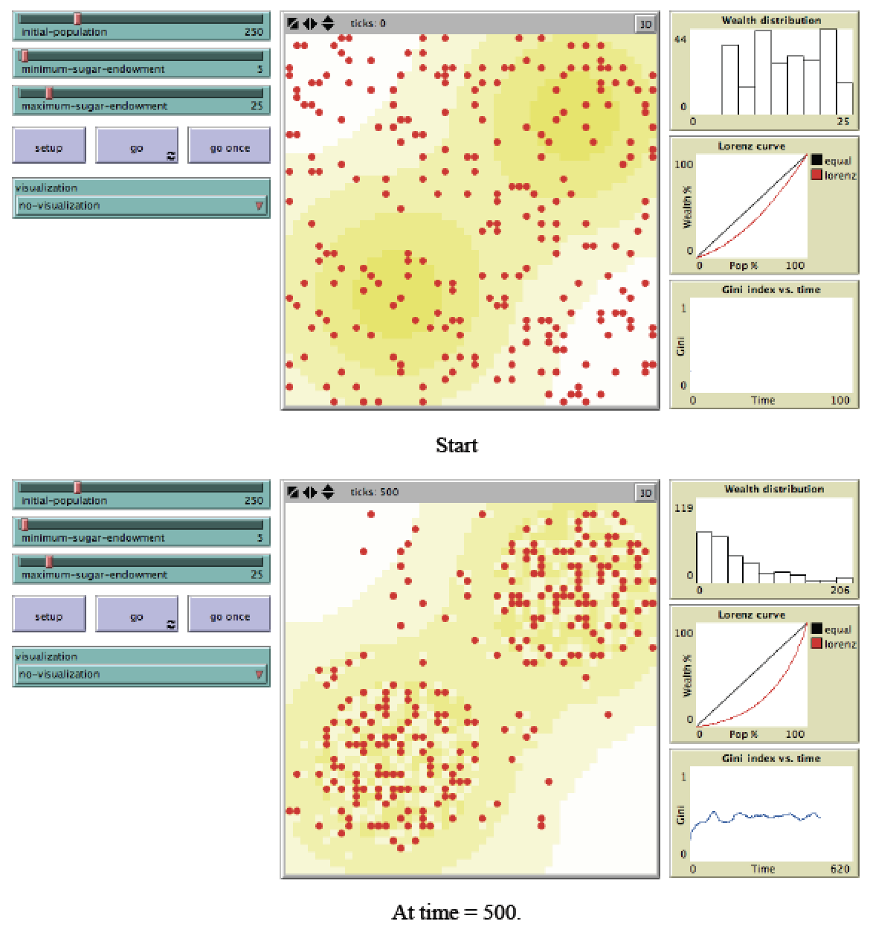
Graphical User Interface of Sugarscape Model
Figure 2.7: Sugarscape wealth distribution model (Source: Li and Wilensky, 2009).

Slide 21
Transportation Modelling

Slide 22
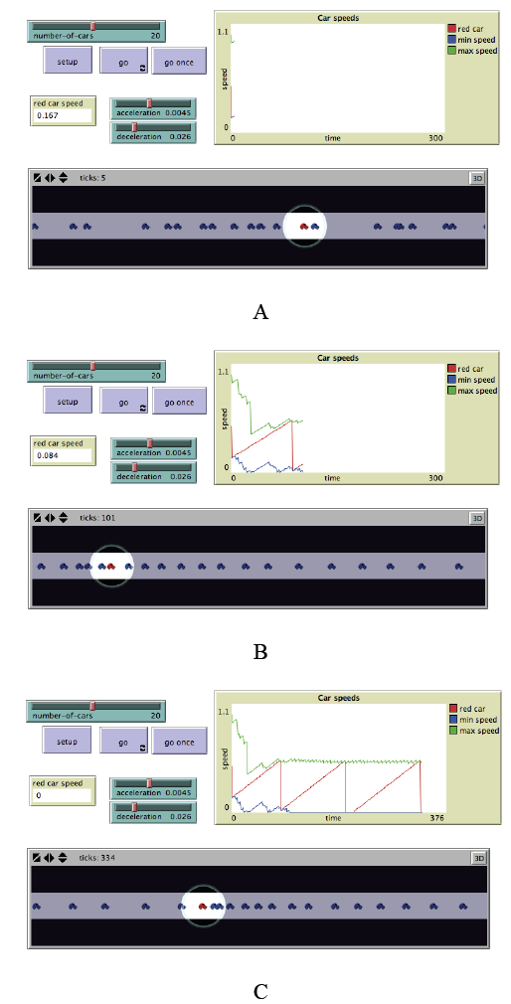
Traffic Modelling
Figure 2.8: Simple traffic model where each car is an agent. In A, B and C from top left clockwise, model parameters, a chart of car speeds and the spatial agent-environment (source: Wilensky, 1997).

Slide 24
Agent-based Models Used for Decision Making
Southwest Airlines used an agent-based model to improve how it handled cargo.
Eli Lilly used an agent-based model for drug development.
Pacific Gas and Electric: Used an agent based model to see how energy flows through the power grid.
Procter and Gamble used an agent-based model to understand its consumer markets.
NASDAQ used and agent based model to explore changes to Stock Market's decimalization.
Macy’s have used agent-based models for store design.
InSTREAM: Explores how river salmon populations react to changes in water conditions.

Slide 25
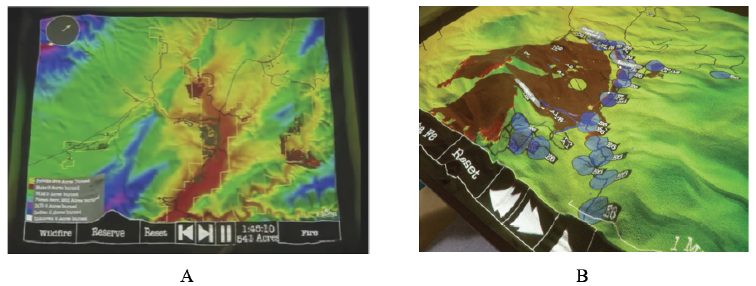
Real World Decision Making
Agent-based modeling has also been used for wild fire training, incident command and community outreach. For example SimTable was used in the 2016 Sand Fire in California.
Figure 2.9: User interface of SimTable: (A) Entire study area, (B): an active fire model (source: SimTable, 2017).
Notes:
Click on image to see a movie on YouTube. Or see https://youtu.be/aLmOxnPKUqk

Slide 26
Summary
Successfully replicating the processes and dynamics that occur within real-world geographical systems is highly challenging.
The notion of bottom-up modelling advocated by agent-based modelling allows the results of local phenomena to be understood and measured at an aggregate level.
Agent-based models allow every individual to be assigned their own characteristics.
This chapter has provided a general introduction to agent-based modelling. The main characteristics of agent-based modelling have been presented along with the advantages and limitations of this approach for geographical systems.
The chapter explored a diverse range of geographical applications of agent-based modelling

Slide 27
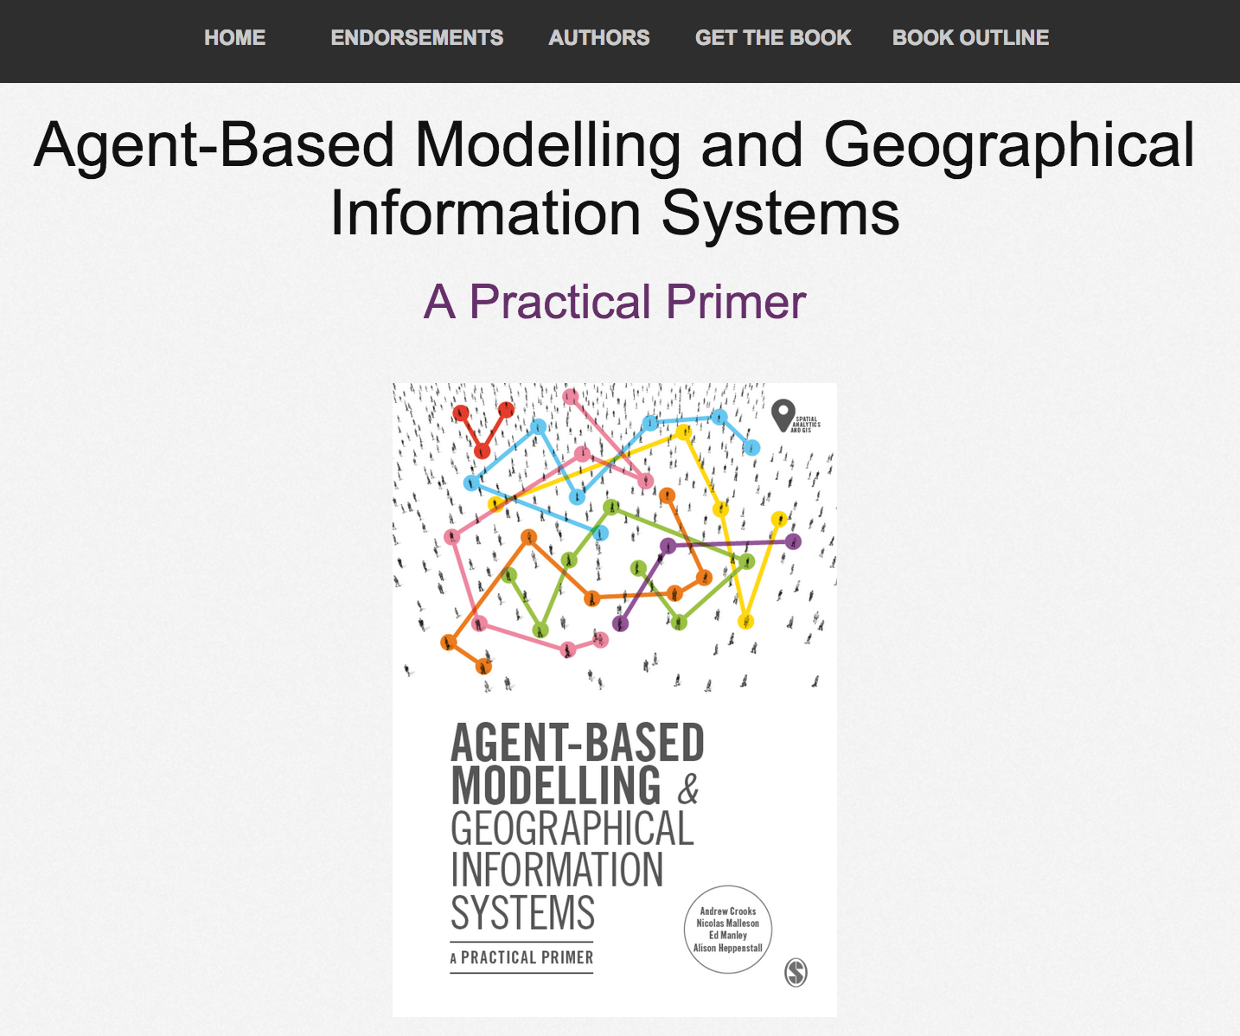
Online Resources
Visit: https://github.com/abmgis/abmgis/tree/master/Chapter02-IntroToABM for a selection of models to highlight core concepts introduced in this chapter

